Slide 1
Capacitive Touch Sensor for Smart Glass
Group Members: Ramsha Qayyum, Su Mon Tun
Advisor: Asst. Prof. Dr.-Ing. Suramate Chalermwisutkul

Slide 2
Content
Conceptual Design
Features
Hardware Components
Software Flowchart
Task Distribution
Project Timeline

Slide 3
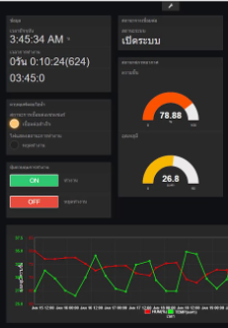

Conceptual Design
Dashboard
ESP8266 (with built-in RTC)
Capacitive Touch Sensor
LEDs

Slide 4
Features
Touch/No Touch Sensing
Proximity Sensing

Slide 5
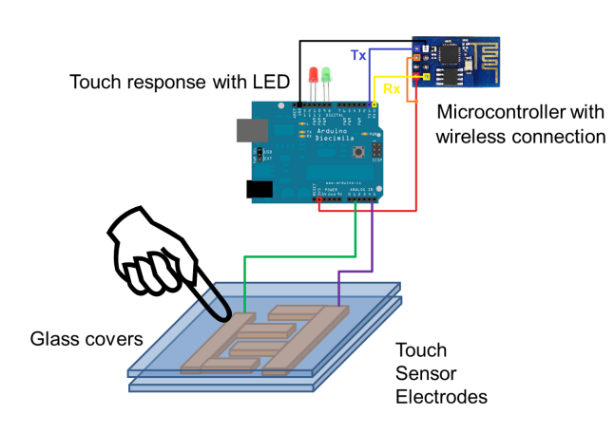
Hardware Components
Main controller board with ESP8266
Glass Sheets with dielectric constant of 7.75
Cu Electrodes
Resistor and LEDs

Slide 6
Software Flowchart
Start
End
Sensing
Uploading to the cloud (NetPie)
Touch found
LED On
No
Yes

Slide 7
Task Distribution
[SW A1.1]: Design electrodes using CST Studio
[SW A1.2]: Simulate the touch scenario
[SW A1.3]: Optimize the electrode design
[HW A1.1]: Fabrication of Electrodes between Glass Sheets
[HW B1.1]: Capacitive Sensor Communication with ESP8266
[HW C1.1]: Comparison of Simulated Values with Experimental Values using LCR meter
[SW B1.1]: NetPie platform GUI for dashboard

Slide 8
Task Distribution
Student Name | Task
Ramsha Qayyum | SW A1.1, SW A1.2, SW A1.3, HW B1.1
Su Mon Tun | HW A1.1, HW C1.1, SW B1.1

Slide 9
Project Timeline
Task | Week
 | 1 | 2 | 3 | 4 | 5 | 6 | 7 | 8
Design Formation | SW A1.1
Software Implementation |  | SW A1.2 | SW A1.3
Hardware Implementation |  |  |  | HW A1.1 |  | HW C1.1
Functional Test |  |  |  |  | HW B1.1 |  | SW B1.1
Documentation |  |  |  |  |  |  |  | X

Slide 10
Thankyou

